Slide 1
COMMUNICATION
AND
NETWORK CONCEPTS
Mrs. Namrata Shah
PGT (Comp. Sci.)
KV ONGC Baroda

Slide 2
What is a Network ?
The collection of interconnected computers is called a computer network.
Two computers are said to be interconnected if they are capable of sharing and exchanging information.

Slide 3
Why it is needed?
Resource Sharing
Reliability
Cost Factor
Communication Medium
Resource Sharing means to make all programs, data and peripherals available to anyone on the network irrespective of the physical location of the resources and the user.

Slide 4
Reliability means to keep the copy of a file on two or more different machines, so if one of them is unavailable (due to some hardware crash or any other) them its other copy can be used.
Cost factor means it greatly reduces the cost since the resources can be shared
Communication Medium means one can send messages and whatever the changes at one end are done can be immediately noticed at another.

Slide 5
EVOLUTION OF NETWORKING
1969 - First network came into existence
ARPANET (ADVANCED RESEARCH PROJECT AGENCY
NETWORK)
MID 80’S - NSFNET (NATIONAL SCIENCE FOUNDATION
NETWORK)

Slide 6
1980 NSFnet
a high capacity network to be used strictly for academic and engineering research.
1969 ARPANET
1990 INTERNET
to connect computers at U.S. defense and different universities.
the internetworking of ARPANET, NSFnet and other private networks
INTERNET IS THE NETWORK OF NETWORKS.

Slide 7
SWITCHING TECHNIQUES
Switching techniques are used for transmitting
data across networks.
Different types are :
Circuit Switching
Message Switching
Packet Switching

Slide 8
CIRCUIT SWITCHING
Circuit switching is the transmission technology that has been used since the first communication networks in the nineteenth century.
First the complete physical connection between two computers is established and then the data are transmitted from the source computer to the destination.
When a call is placed the switching equipment within the system seeks out a physical copper path all the way from the sender to the receiver.
It is must to setup an end-to-end connection between computers before any data can be sent.
The circuit is terminated when the connection is closed.
In circuit switching, resources remain allocated during the full length of a communication, after a circuit is established and until the circuit is terminated and the allocated resources are freed.

Slide 9
MESSAGE SWITCHING
In this the source computer sends data or the message to the switching circuit which stores the data in its buffer.
Then using any free link to the switching circuit the data is send to the switching circuit.
Entire message is sent to the destination. It reaches through different intermediate nodes following the “store and forward” approach.
No dedicated connection is required.

Slide 10
PACKET SWITCHING
Conceived in the 1960's, packet switching is a more recent technology than circuit switching .
Packet switching introduces the idea of cutting data i.e. at the source entire message is broken in smaller pieces called packets which are transmitted over a network without any resource being allocated.
Then each packet is transmitted and each packet may follow any rout available and at destination packets may reach in random order.
If no data is available at the sender at some point during a communication, then no packet is transmitted over the network and no resources are wasted.
At the destination when all packets are received they are merged to form the original message.
In packet switching all the packets of fixed size are stored in main memory.

Slide 11
TRANSMISSION MEDIA
Data is transmitted over copper wires, fiber optic cable, radio and microwaves. The term 'media' is used to generically refer to the physical connectors, wires or devices used to plug things together.

Slide 12
Basic Communications Media Types
Copper
  Unshielded Twisted Pair (UTP)
  Shielded Twisted Pair (STP)
  Coaxial Cable (Thinnet, Thicknet)
Fiber Optic
  Single-mode
  Multi-mode
Infrared
Radio & Microwave

Slide 13
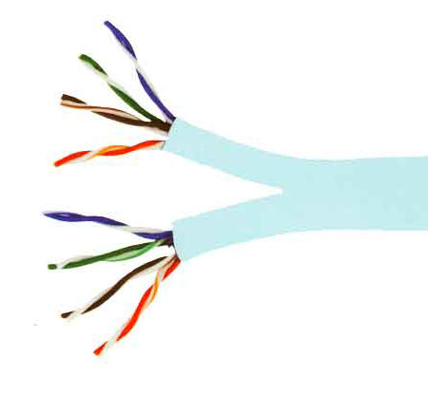
Twisted Pair Cable
These cables consist of two insulated copper wires twisted around each other in a double helix.
Twisting of wires reduces crosstalk which is bleeding of a signal from one wire to another.

Slide 14
TYPES:
  Unshielded Twisted Pair (UTP)
  Shielded Twisted Pair (STP)
STP offers greater protection from interference and crosstalk due to shielding.
But it is heavier and costlier than UTP
USE
In local telephone communication
For digital data transmission over short distances upto 1 km

Slide 15
Advantages
Easy to install and maintain
Simple
Inexpensive
Low weight
Suitable for small (Local) Networks
Disadvantages
Not suitable for long distance due to high attenuation.
Low bandwidth support.
Low Speed

Slide 16
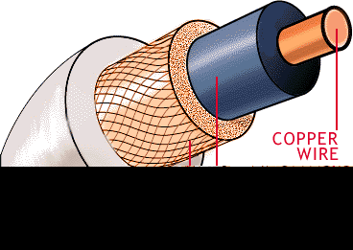
Coaxial cable
Coaxial cable consists of a solid copper wire core surrounded by a plastic cladding shielded in a wire mesh.
Shield prevents the noise by redirecting it to ground.

Slide 17
TYPES:
Coaxial cable comes in two sizes which are
called thinnet and thicknet.
Thicknet : segment length upto 500 m
Thinnet : segment length upto 185 m
USE
In TV channel communication

Slide 18
Advantages
Better than twisted wire cable.
Popular for TV networks.
Offers higher bandwidth & Speed
Disadvantages
Expensive than twisted wires.
Not compatible with twisted wire cable.

Slide 19
OPTICAL FIBRES
Thin strands of glass or glass like material designed to carry light from one source to another.
Source converts (Modulates) the data signal into light using LED (Light Emitting Diodes) or LASER diodes and send it over the Optical fiber.
It consists of three parts:
The core : glass or plastic through which the light travels.
The cladding : covers the core and reflects light back to the core
Protective coating : protects the fiber cable

Slide 20
Advantages
Not affected by any kind of noise.
High transmission capacity
Speed of Light
Suitable for broadband communication
Disadvantages
Installation requires care.
Connecting two Optical fibers is difficult.
Optical fibers are more difficult to solder
Most expensive.

Slide 21
Types
Single mode
Multi mode
USE
In LAN
For long transmission

Slide 22
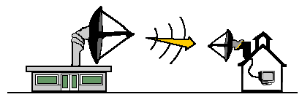
Microwaves
Microwaves are transmitted from the transmitters placed at very high towers to the receivers at a long distance.

Slide 23
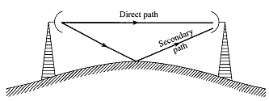
Microwaves are transmitted in line of sight fashion, and also propagated through the surfaces.

Slide 24
MICROWAVES
Advantages
Maintenance easy than cables.
Suitable when cable can not be used.
Disadvantages
Repeaters are required for long distance communication.
Less Bandwidth available.

Slide 25
Satellite
Geostationary satellites are placed around 36000 KM away from the earth’s surface.

Slide 26
Satellite
In satellite communication transmitting station transmits the signals to the satellite. (It is called up-linking)
After receiving the signals (microwaves) it amplifies them and transmit back to earth in whole visibility area.
Receiving stations at different places can receive these signals. (It is called down-linking).

Slide 27
Satellite

Slide 28
Satellite
Advantage
Area coverage is too large
Disadvantage
High investment

Slide 29
PROTOCOLS
A protocol means the rules that are applicable for a network.
It defines the standardized format for data packets, techniques for detecting and correcting errors and so on.
A protocol is a formal description of message formats and the rules that two or more machines must follow to exchange those messages.
Eg using library books.

Slide 30
HTTP
Hypertext Transfer Protocol (HTTP) is a communications protocol for the transfer of information on the intranet and the World Wide Web. Its original purpose was to provide a way to publish and retrieve hypertext pages over the Internet .
HTTP is a request/response standard between a client and a server. A client is the end-user, the server is the web site.

Slide 31
FTP
FTP (File Transfer Protocol) is the simplest and most secure way to exchange files over the Internet.
The objectives of FTP are:
To promote sharing of files (computer programs and/or data).
To encourage indirect or implicit use of remote computers.
To shield a user from variations in file storage systems among different hosts.
To transfer data reliably, and efficiently.

Slide 32
ADVANTAGES Of FTP
It is very useful to transfer files from one n/w to in an organisation to another
It is an effective way to ger a geographically dispersed group to co-operate on a project.
It is a potent and popular way to share information over the internet.

Slide 33
TCP/IP

Slide 35
SLIP/PPP

Slide 36
BOARD QUESTIONS
(a) Explain function of hub and router. 1
(b) Expand the following terms: 2
(i) URL (ii) ISP (iii) DHTML (iv) CDMA
(c) Differentiate between message switching and packet switching 1
(d) Indian Industries has the following four buildings in Chennai.
Distance between various wings is given below:
A
B
C
D

Slide 37
Wing A to Wing C | 70m
Wing A to Wing B | 20m
Wing A to Wing D | 115m
Wing C to Wing D | 30m
Wing B to Wing C | 25m
Number of Computers
Wing A | 35
Wing B | 25
Wing C | 80
Wing D | 60

Slide 38
Suggest suitable CABLE LAYOUTS FOR THESE BUILDINGS. 1
Name the wing where the Server is to be installed. Justify your answer. 1
Suggest the placement of Hub/Switch in the network. 1
Mention an economic technology to provide Internet accessibility to all wings. 1

